Slide 1
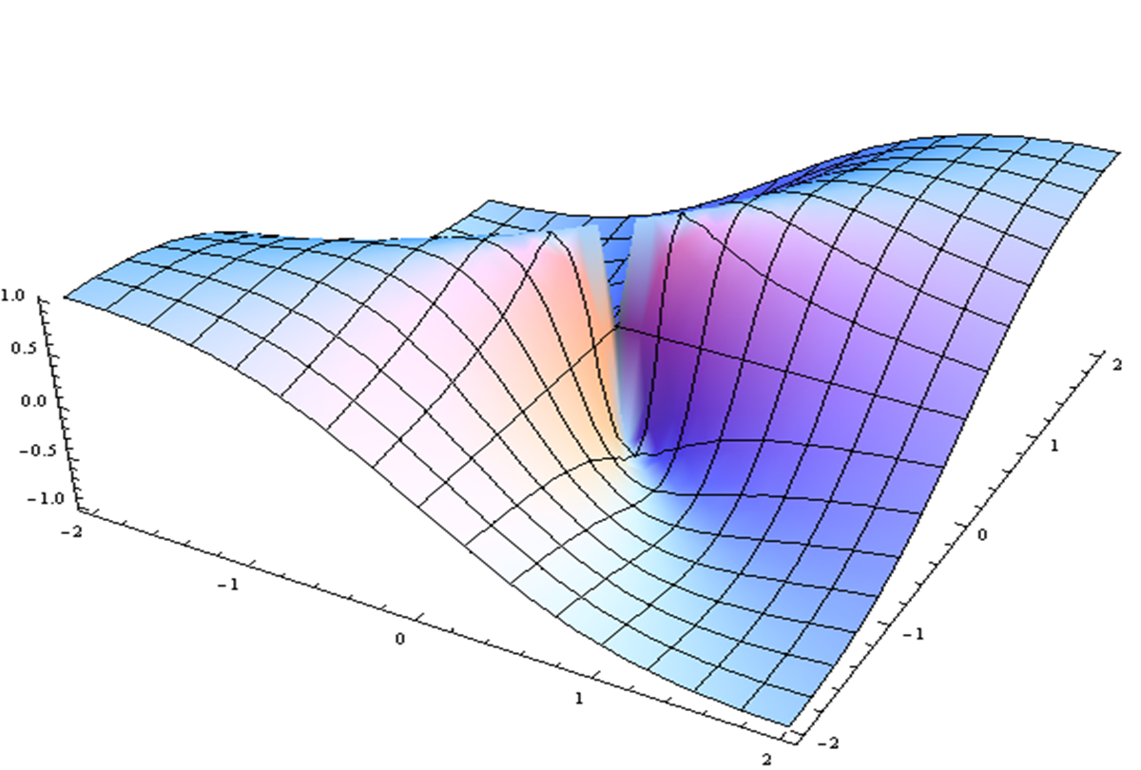
Current & Future Models: Big Data, AI, Cohorts, in Silico etc
Frank Hu, Gary Fraser, Michael Silva, Steven Chang, Ron Poropatich, Paul Verschure, Oscar Marroquin

Slide 2
Machine Learning and Mechanistic Models in Concert
Machine Learning (“data” driven)
Mechanistic models (“theory” driven)
Can discover patterns in raw data in absence of solid theory
Extrapolation is more difficult without very large amounts of data
Inefficient when solid theory exists:
Requires enough data to rediscover relevant theory for itself
Naturally incorporates known science and causality
Provides built-in sanity check against spurious patterns in data
Not useful for problems with weak/absent underlying theory
These approaches complement each other:
- Leverage known theory with mechanistic model
- Let ML model fill in gaps in mech model's theory

