Slide 1
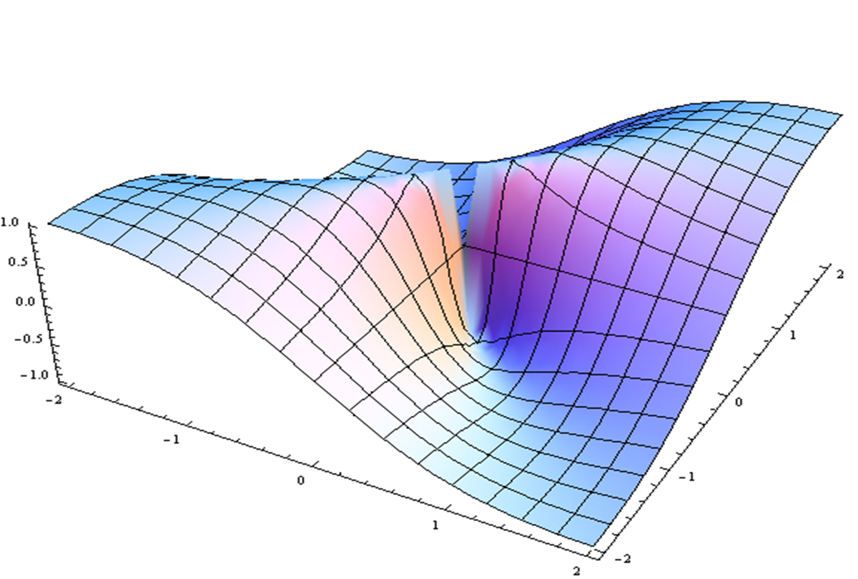
Federal and Foundation Perspectives
Art Levine, Eduardo Sanchez, Steven Woolf, Caesar Junker, Eddie Phillips

Slide 2
Veterans Administration: Whole Health Edward M. Phillips, MD, VA Boston Healthcare System
Personalized
Pro-Active
Patient Driven
Changing the conversation from “What is the matter with you?” to “What matters to you?”
Helping Veterans achieve their “Mission, Aspiration and Purpose” by empowering, equipping and caring.

Slide 3
Lifestyle Medicine Research Summit
December 4, 2019
Eduardo Sanchez, MD,MPH,FAAFP
Chief Medical Officer for Prevention
Chief, Center for Health Metrics and Evaluation
American Heart Association

Slide 4
American Heart Association
Oldest and largest charitable health organization in the United States dedicated to fighting heart disease and stroke
Founded in 1924 by six cardiologists
4,000 employees and more than 25 million volunteers and supporters in more than 156 local offices
2nd largest funder of research related to heart disease and stroke - $180 million in 2018
The nation’s leader in CPR education training
Developer and promulgater of science-based treatment guidelines for healthcare professionals to provide science-derived, evidence-based quality care to their patients.
Provider of health education to help people understand the importance of healthy lifestyle choices.
Known for its advocacy for changes to protect and improve the health of our communities.

Slide 5
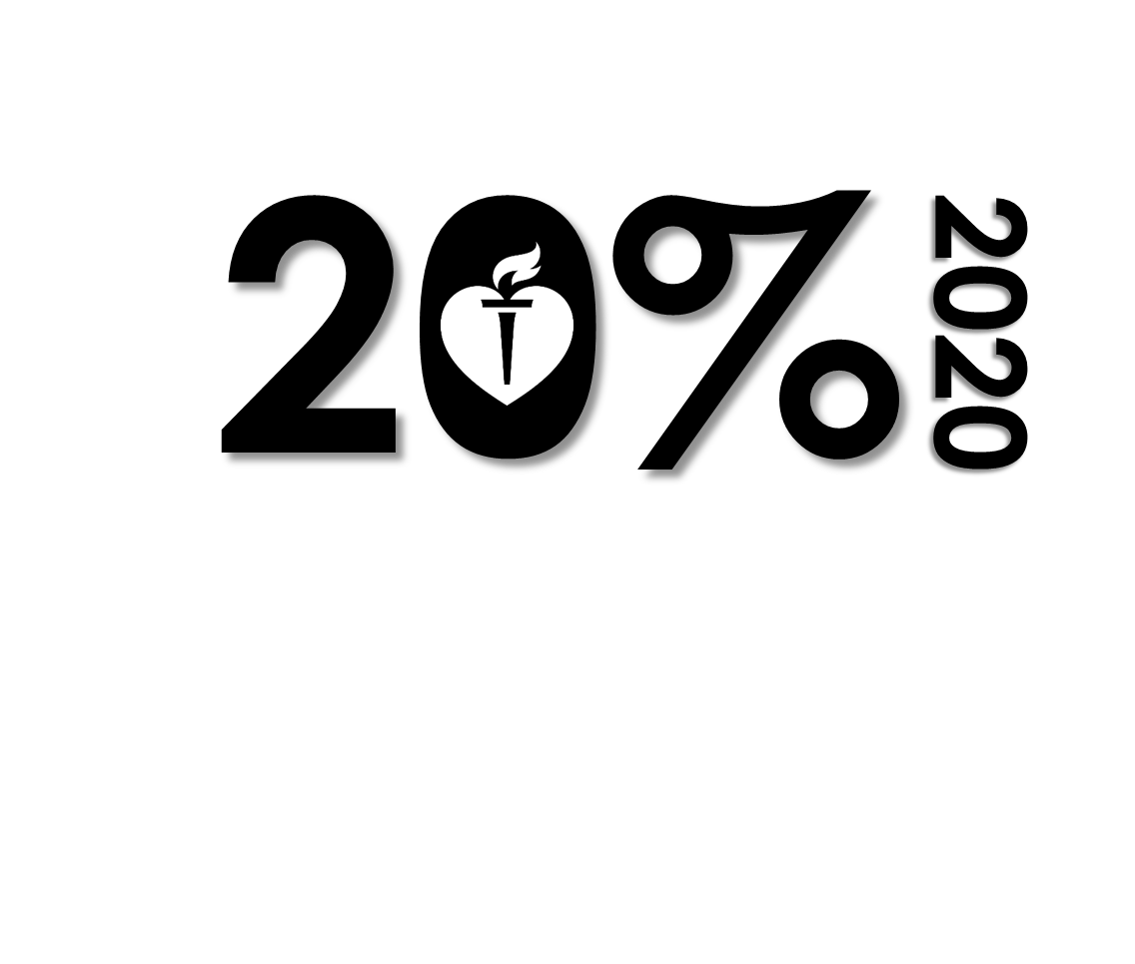
American Heart Association 2020 Goal
By 2020, improve the cardiovascular health of all Americans by 20% while reducing deaths from cardiovascular diseases & stroke by 20%.
Life’s Simple 7
Smoking Status
Physical Activity
Healthy
Diet
Healthy Weight
Blood Glucose
Total
Cholesterol
Blood Pressure

Slide 6
Ideal cardiovascular health
… the absence of clinically manifest cardiovascular disease together with the simultaneous presence of optimal levels of Life’s Simple 7 metrics, including
1) not smoking and
2) having a healthy diet pattern,
3) recommended levels of physical activity,
4) normal body weight, and
5) normal levels of total cholesterol,
6) blood pressure, and
7) fasting blood glucose,
in the absence of drug treatment.
Benjamin et al; Circulation 2017

Slide 7
Top 11 Risk factors contributing to death and disability combined in the United States in 2017
High body mass index
Tobacco
Dietary risks
High fasting plasma glucose
High blood pressure
Drug use
Alcohol use
High LDL cholesterol
Impaired Kidney Function
Occupational risks
Air pollution
http://www.healthdata.org/united-states, Institute for Health Metrics and Evaluation (IHME),
Accessed 4/14/2019

Slide 8
2019 ACC/AHA Guideline on the Primary Prevention of Cardiovascular Disease
All adults should be assessed at every visit for tobacco use.
All adults should consume a healthy diet which emphasizes the intake of vegetables, fruits, nuts, whole grains, lean protein, and fish and minimizes the intake of trans fats, processed meats, refined carbohydrates, and sugar-sweetened beverages.
Adults should engage in at least 150 minutes per week of accumulated moderate intensity or 75 minutes per week of vigorous intensity physical activity.
Arnett, D., Blumenthal, R., et al. Circulation, 2019.

Slide 9
2019 ACC/AHA Guideline on the Primary Prevention of Cardiovascular Disease
For adults who have overweight or obesity, counseling and caloric restriction are recommended for achieving and maintaining weight loss
Nonpharmacological interventions are recommended for all adults with elevated blood pressure or hypertension. For those requiring pharmacologic therapy, the target blood pressure should generally be less than 130/80 mm Hg.
Statin therapy is first-line treatment for primary ASCVD prevention in:
Patients with elevated LDL-C levels (>190 mg/dl),
Those with diabetes,
Those at sufficient ASCVD risk following a clinician-patient risk discussion
For adults with type 2 diabetes mellitus, lifestyle changes such as improving dietary habits and achieving exercise recommendations are crucial. If medication is indicated, metformin is first-line therapy followed by consideration of an SGLT-2 inhibitor or a GLP-1 receptor agonist.
Arnett, D., Blumenthal, R., et al. Circulation, 2019.

Slide 10
CPSTF Recommendations for Life’s Simple 7
Tobacco
Nutrition
Physical Activity
Obesity
Cardiovascular Disease
Diabetes
Community Preventive Services Task Force; www.thecommunityguide.org

Slide 11
CPSTF Recommendations for Health Equity
Intervention | CPSTF determination
Center-Based Early Childhood Education | March 2015
School-Based Health Centers | March 2015
High School Completion Programs | December 2013
Full-Day Kindergarten Programs | December 2011
General, Reading, and Math-Focused Out-of-School-Time Academic Programs | December 2013
Tenant-Based Rental Assistance Programs | February 2001
Community Preventive Services Task Force; www.thecommunityguide.org

Slide 12
TFAH: Promoting Health & Cost Control in States Report: Goals & Related Policy Recommendations
Goal 1: Support the Connections Between Health & Learning
1. Universal Pre-Kindergarten
2. Enhancing School Nutrition Programs
Goal 4: Promote Active Living & Connectedness
7. Complete Streets
Goal 5: Ensure Safe, health, and Affordable Housing for All
7. Housing Rehabilitation Loan & Grant Programs
8. Rapid Re-Housing
Goal 2: Employ Harm-Reduction Strategies to Prevent Substance Misuse Deaths and Related Diseases
3. Syringe Access Programs
Goal 6: Create Opportunities for Economic Well-Being
10. Earned Income Tax Credit
11. Paid Family Leave
12. Earned Sick Leave
13. Ban the Box (Fair Hiring Protections)
Goal 3: Promote Healthy Behavior
4. Smoke-Free Policies
5. Tobacco Pricing Strategies
6. Alcohol Pricing Strategies
Notes:
What is PHACCS?
PHACCS seeks to inform state policymakers and public health advocates of effective state policies to improve health and control costs in a relatively short period of time
PHACCS focuses on state-level policies that can be adopted and implemented to promote health and control cost growth
PHACCS looks beyond health care in an effort to foster cross-sector collaboration, recognizing impacts in other sectors can impact population’s well-being and states’ strategies to control costs
How were the policies selected?
TFAH reviewed over 1,500 policies, programs and strategies from the following databases: The Community Guide, County Health Rankings & Roadmaps, Health Impact in Five Years, Win-Win Project, Pew-MacArthur Results First Initiative, and CityHealth
TFAH applied a set of four criteria for inclusion:
The policy has a sufficient health and economic evidence (evidence-based policies)
A clear state-level policy role (legislative enactment needed)
The policy addresses populations has a whole (population-based)
The policy is a form of primary or secondary prevention (preventive policy)

Slide 13
Lifestyle Medicine
WHAT? -We, generally, know what we need to do.
HOW? - We, generally, do not know how to get it done.
What about electronic cigarettes and vaping?

Slide 14
Closing Thoughts: Lifestyle Medicine Research
Clinical preventive services (USPSTF)
Population level research (CPSTF)
Policy implementation research (DPP)
Program implementation research (DPP)
Health services research (multidisciplinary, health teams)
Cost effectiveness research
Value-based benefit design research

Slide 15
Hans Rosling (1948-2017)
Celebrity statistician; Gapfinder co-developer
“I’m not an optimist.
I’m a very serious possibilist.”

