Slide 1
Welcome to Pittsburgh & Lifestyle Medicine Research Summit
Ron Stout, MD Ardmore Institute of Health
Michael Parkinson, MD UPMC Health Plan & WorkPartners
Yoram Vodovotz, PhD University of Pittsburgh

Slide 2
“Begin With The End in Mind”
Define research priorities in core areas of lifestyle medicine
Existing knowledge and gaps related to lifestyle behaviors (and environment) to leading causes of death, disease and disability
Emphasis on clinical treatment and reversal of chronic disease
Create new insights, breakthroughs and/or collaboration from often-siloed practice, populations, methods and perspectives spanning:
Lifestyle-induced or -associated inflammation, Immune dysfunction
Cellular dysbiosis and microbiome alterations
Genomics, epigenetics, proteomics, metabolomics
Neuroplasticity and other physiologic pathways to health and disease
Emerging innovative approaches to research methods and models
Opportunities for population-based and/or banked serological/specimen investigations
using existing cohorts
Summary White Paper(s) for dissemination and publication in nationally-prominent journal(s)

Slide 3
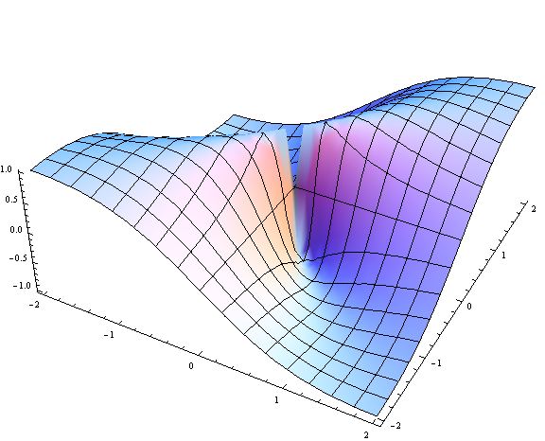
Perspective Intersection to Produce High Value Innovative Research
in Lifestyle Medicine Science, Practice and Impact
Epigenetics/
Biology/Physiology/
Microbiome,
Neuroplasticity
Clinical Outcomes
Analysis Method
(Basic science, clinical trial,
cohort, big data, AI, modeling)
Lifestyle Medicine Domain
(Diet, Activity, Stress, Sleep,
Relationships, Addictions)

Slide 4
Our Journey At A Glance
Day 1: “Deep Dive”
Domain-specific expert(s) overview, research recommendations and discussions
Built environment/choice architecture and exposures
Phipps Conservatory Reception, Tour and Dinner
“Across, Between and Beyond Silos: A Hierarchy of Evidence”
Day 2: “Cross-cutters”
New science and common pathways
Applied clinical research and integrative medicine
Underserved and understudied populations/perspectives
Current and future research methods and models
Federal and foundation perspectives
Summary and white paper(s) next steps

Slide 5
US Age-group Specific Mortality Rates 1999-2017*
Mortality Rates Rising (after decades of decline)
US life expectancy plateaued in 2011
- Most significant decline in middle-age groups

Slide 6
US Age Group-specific Mortality Rates by Cause 1999-2017*
Increased mortality in
midlife age groups
- Drug and alcohol use
- Suicides
- Hypertensive diseases
- Diabetes
- (Obesity)
*Woolf SH, Schoomaker H;
JAMA 2019:322(20):1996-2016

Slide 7
NIH Prevention Research 2012-17*
Primary and secondary prevention research comprise 17% of total NIH portfolio
11,082 research projects identified
26% address leading cause of death as outcome
Heart disease, cancer, accident, COPD, stroke etc
34% address leading risk factor for death
Diet, tobacco, BP, BMI, elevated FBS, high cholesterol, etc
31% address leading causes of disability life years
High BMI, tobacco, dietary risk, drug/alcohol use etc
Only 25% involved RCT’s; 3% multiple causes of death and 8% multiple risk factors

Slide 8
NIH Prevention Research By Population Focus 2012-17*
20% or less
- Youth
10% or less
- Older
- Urban
- Pregnant
5% or less
- Low income
- Rural
- Sexual minorities
- Institutionalized
- People with disabilities
*Vargas AJ et al. JAMA Network Open 2019;2(11):e1914718

Slide 9
NIH Prevention Research Methods 2012-17*
Observational 60%
Analysis existing data 40%
RCT 25%
Other or unclear 10%
*Vargas AJ et al. JAMA Network Open 2019;2(11):e1914718

Slide 10
NIH Prevention Research by Type 2012-17*
Preventing new 60%
Slowing progression 30%
Methods 20%
Screening disease 10%
Screening risk factor 2%

Slide 11
Lifestyle Medicine is the use of a whole food, plant-predominant dietary lifestyle, regular physical activity, restorative sleep, stress management, avoidance of risky substances and positive social connection as a primary therapeutic modality for treatment and reversal of chronic disease.
American College of Lifestyle Medicine

Slide 12
Steps in the Pathogenesis of Inflammation Progressing to Chronic Disease*
Microbiome dysbiosis
Obesity
Type 2 DM
CVD
Cancer
Depression
Other Diseases
Unhealthy Diet
Sedentary Lifestyle
High Stress
Medications
Poor Sleep
Addictions
Social Isolation
Chronic
Inflammation
Oxidative stress
Cell injury
*Adapted from Bodai et al. Lifestyle medicine: A brief review of its dramatic impact on health and survival. PermJ 2018;22:17-025 (Italics added)

Slide 13
New Science of Rapid Change in Response to Behaviors: Epigenetics

Slide 14
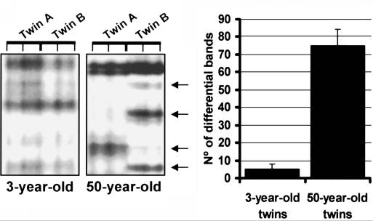
Epigenetic Differences in Monozygotic-twins
Fraga, et al. Epigenetic differences arise during the lifetime of monozygotic twins. PNAS 2005;102:10604.

Slide 15
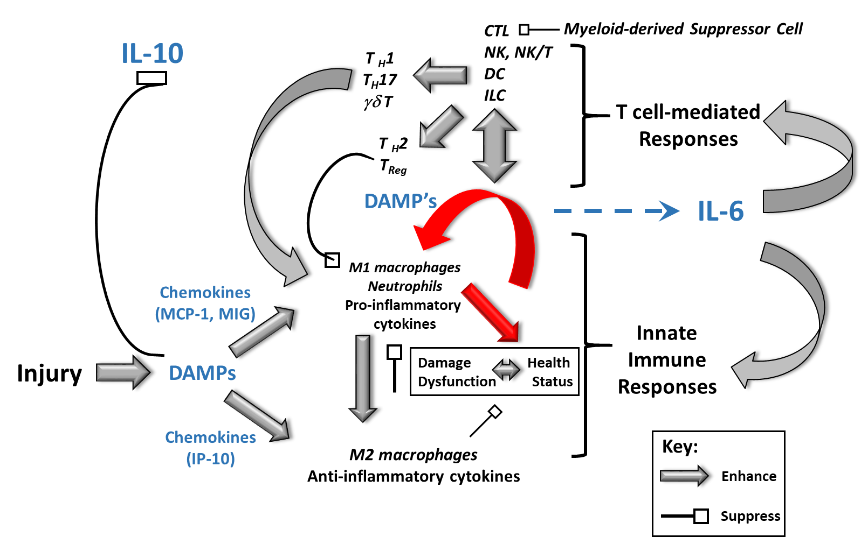
Inflammation is complex…
Stress
Namas et al. Antiox. Redox Signaling. 2015. 10:1370

Slide 16
Modeling as a Means for Optimizing Healthcare: A Translational Systems Biology Framework
Pre-clinical studies
Clinical
trials
Long-term Outcome
In-hospital
Simulate Mechanism
Simulate Clinical Trial
Simulate Individual Patient
Simulate Aging, etc.
Adapted from Y. Vodovotz et al. Math. Biosci. 2009. 217:1

Slide 17
Perspective Intersection to Produce High Value Innovative Research in
Lifestyle Medicine Science, Practice & Impact
Basic Science Clinical & Pop Trials Big Data AI In Silico Modeling
Analysis Methodology
Inflammation Epigenetics Microbiome Dysbiosis Neuroplasticity
Biology / Physiology
Sleep
Nutrition
Addictions
Physical Activity
Social Relationships
Lifestyle Medicine
Domains
Mindfulnes/Stress/Resilience

Slide 18
Lifestyle Medicine & Environmental Health Grand Rounds Children’s Hospital Pittsburgh Jan 2017
10 y/o African American male with history of obesity, asthma, bipolar disorder, and ADHD presenting for well child check.
Has had intermittent chest pain but otherwise no acute complaints. Mother accompanies him and is concerned about his diet.
Dietary History
3 meals per day, typically in front of TV
Fast food 2x / week
Drinks Mountain Dew or lemonade, occ. water
Past Medical History
Born FT, breastfed for one month
Asthma: multiple ED visits and admissions, no ICU stays
ADHD, Bipolar disorder
Medications
Albuterol PRN, Vyvanse, Abilify
Family History
Mother is overweight, has type II diabetes, hypertension
Father is overweight, has hypertension
Maternal grandfather died of MI
Paternal grandfather victim of homicide
Social History
Resides in Hill district with parents
Is in 5th grade- frequently bullied
Father smokes in the home
Physical Examination
Wt 65 kg, Ht 140.7cm, BMI 32 = 99%ile
T 37.6, HR 100, R 20, BP 135/70, O2 sat 98% on RA
Gen: NAD
HEENT: PERRLA, EOMI, oropharynx unremarkable
CV: RRR, normal S1 and S2
RESP: CTAB, no wheezes, normal work of breathing
ABD: Obese, soft, NT, ND. Liver edge palpable 1-2 cm below costal margin.
MSK: No swelling or deformity.
Derm: Acanthosis nigricans noted in posterior neck folds and axillae
Neuro: Normal mental status, no focal deficits
Laboratory Testing
Random blood glucose: 107 mg/dL
Total cholesterol: 210 mg/dL
LDL: 162 mg/dL
HDL: 28 mg/dL

Slide 19
REAL Triple Aim for Healthy Individuals and Communities What I Eat, How I Move, What I “Think”
“Think”:
Purpose, passion, connection, spirituality,
Mindfulness & stress reduction
Home
Work
“Eat” Whole-food, plant-based
“Move”
Daily physical activity
School
Neighborhood

Slide 20
Information& Logistics
Will keep to times to allow fullest participation of all invitees
Snacks and beverages available throughout the meeting
Pitt shuttles to Phipps Conservatory depart promptly after final presentation today at 5PM
Pitt shuttles return to Wyndham hotel at conclusion of Phipps Conservatory event
“Expert on-the-street” brief video interviews available over course of meeting in second-floor lobby
Why is this Summit important? Key points you’d like to make to colleagues or research community? What have you learned new or different here?
Network. Think “outside the box, around corners, across silos”.
Enjoy!

