Slide 1
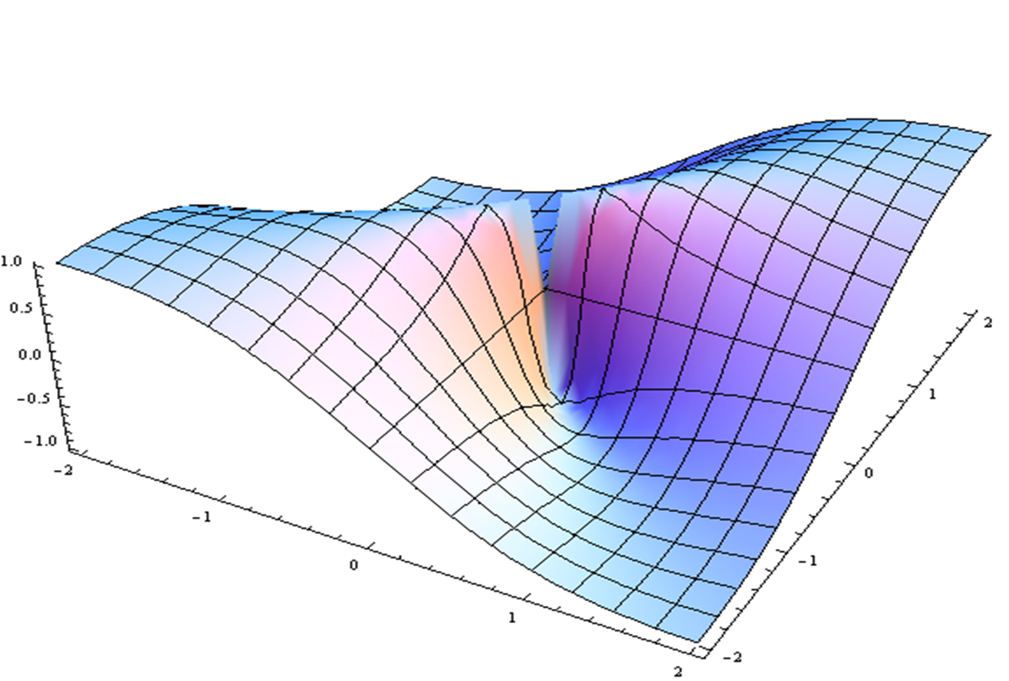
Sleep Overview & Prioritized Research
Dan Buysse
Reactors: Patrick Strollo, Wayne Dysinger, Abbe de Vallejo

Slide 2
Sleep and circadian rhythms: The foundation of a healthy lifestyle
Daniel J. Buysse, MD
UPMC Professor of Sleep Medicine
Professor of Psychiatry and Clinical and Translational Science
University of Pittsburgh School of Medicine
buyssedj@upmc.edu, www.sleep.pitt.edu
Lifestyle Medicine Research Summit: From Molecule to Model
Pittsburgh, PA
December 4-5, 2019

Slide 3
Conflict of Interest Disclosures
 | The presenter does not have any potential conflicts of interest to disclose
X | The presenter wishes to disclose the following potential conflicts of interest:
Type of Potential Conflict | Details of Potential Conflict
Grant/Research Support | None
Consultant | Bayer, BeHealth Solutions, Cereve/Ebb Therapeutics, Emmi Solutions, Pear Therapeutics, Weight Watchers International
Speakers’ Bureaus | None
Financial support | None
Licensing fees | Pittsburgh Sleep Quality Index (PSQI), Daytime Insomnia Symptoms Scale (DISS), Insomnia Symptoms Questionnaire (ISQ), Consensus Sleep Diary (CSD), SATED and RU_SATED Scales
Educational products | CME Institute, American Academy of Physician Assistants, Eisai
 | The material presented in this lecture has no relationship with any of these potential conflicts
X | This talk presents material that is related to one or more of these potential conflicts, and references are provided throughout this lecture as support.

Slide 4
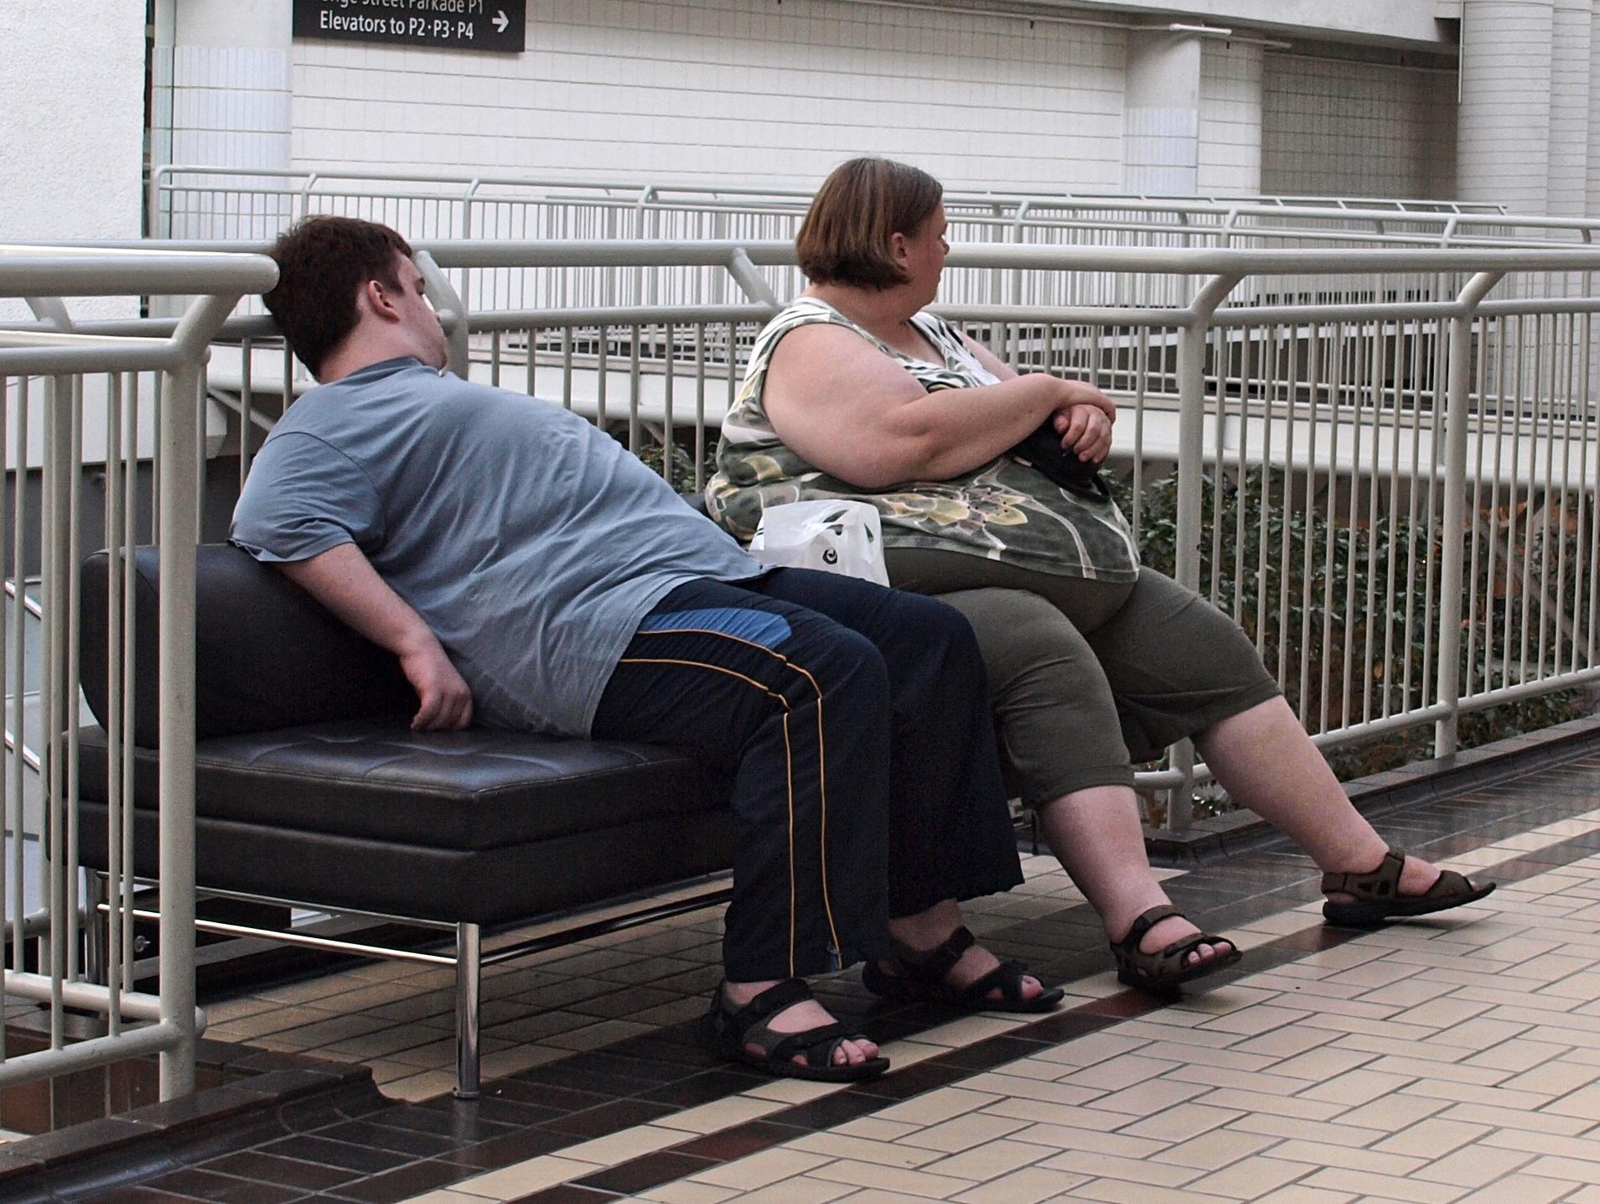
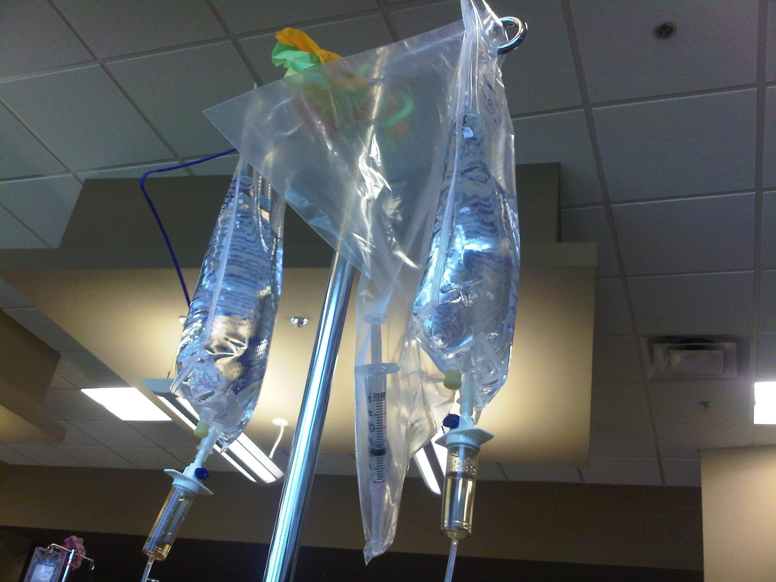
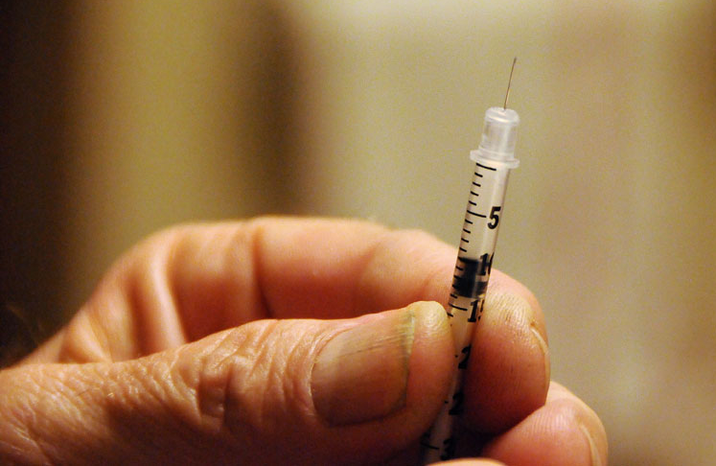
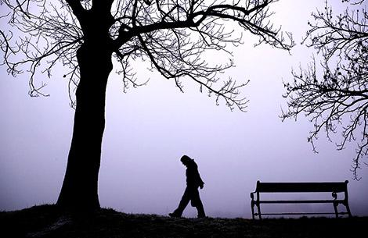
https://www.flickr.com/photos/73416633; https://www.flickr.com/photos/momboleum/3583787090; https://www.flickr.com/search/?text=chemotherapy

Slide 5
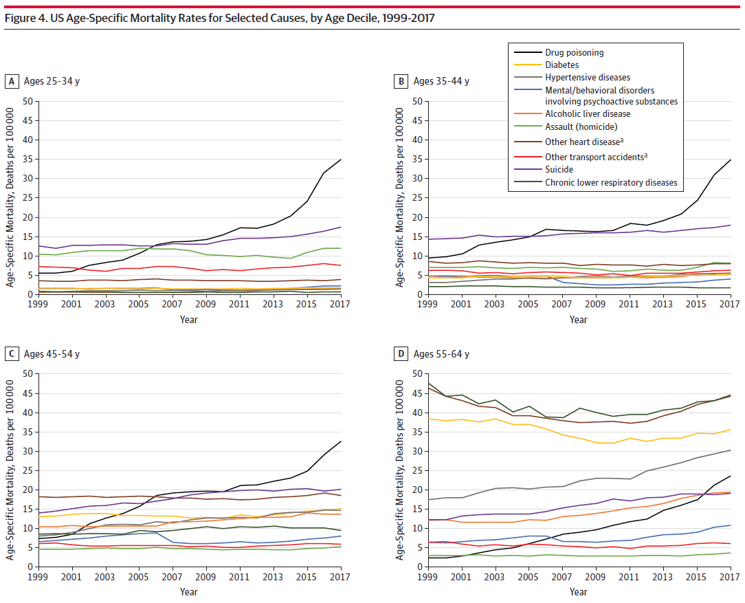
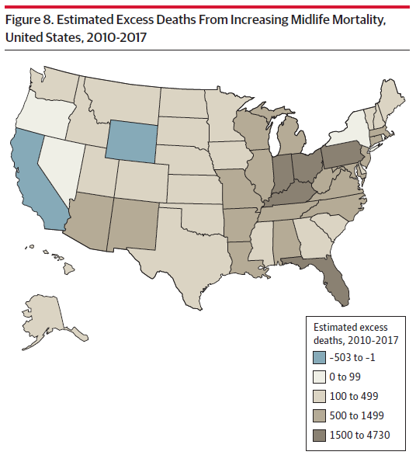
Woolf & Schoomaker, 2019; JAMA 322: 12290-1016

Slide 6
Inflammation
Chronic Disease
Oxidative Stress
Immune
Dysfunction
Epigenetic
Modification

Slide 7
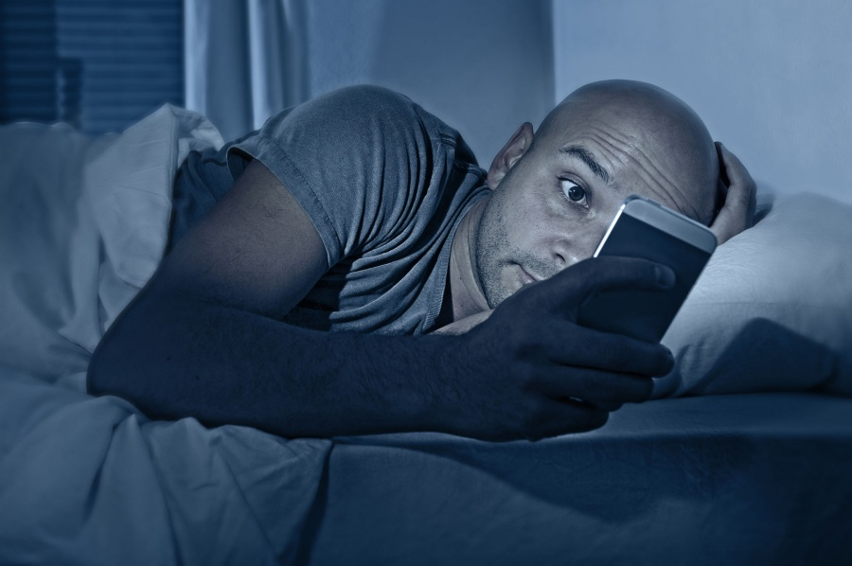
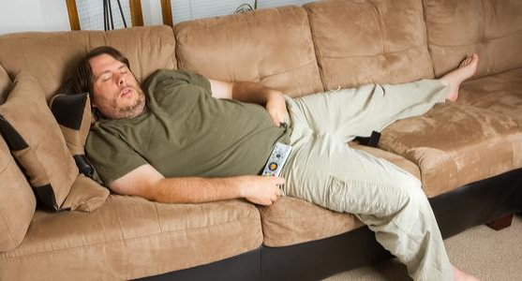

Slide 8
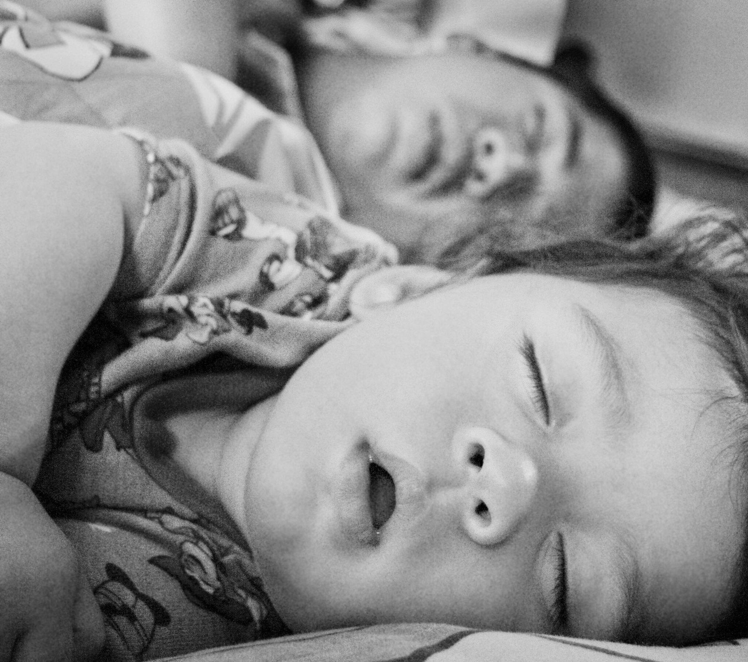
https://www.flickr.com/photos/22868081@N05/6178261021

Slide 9
https://www.flickr.com/photos/mkochan/6304374507

Slide 12
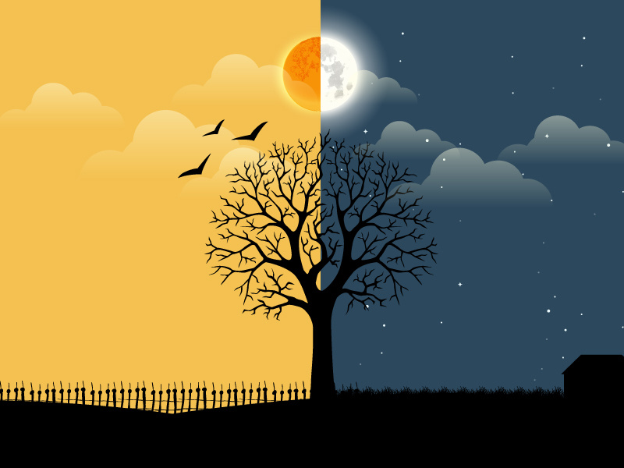
We live in two worlds…

Slide 14
Life is rhythmic
Time Frame
Examples
Term
Milliseconds
Seconds
Minutes
Hours
Day
Weeks
Months
EEG
Breathing
Sleep stages
Rest-activity
Sleep-wake, Hormones
Menstrual cycle
Migration
Ultradian
Circadian
Ultradian
https://www.flickr.com/photos/xerones/26564307

Slide 15
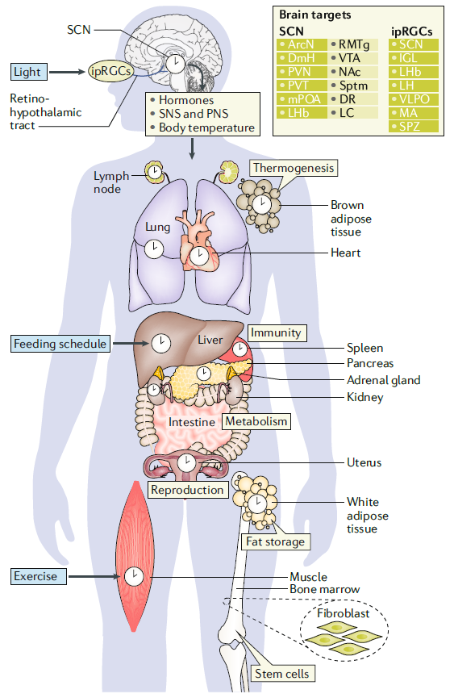
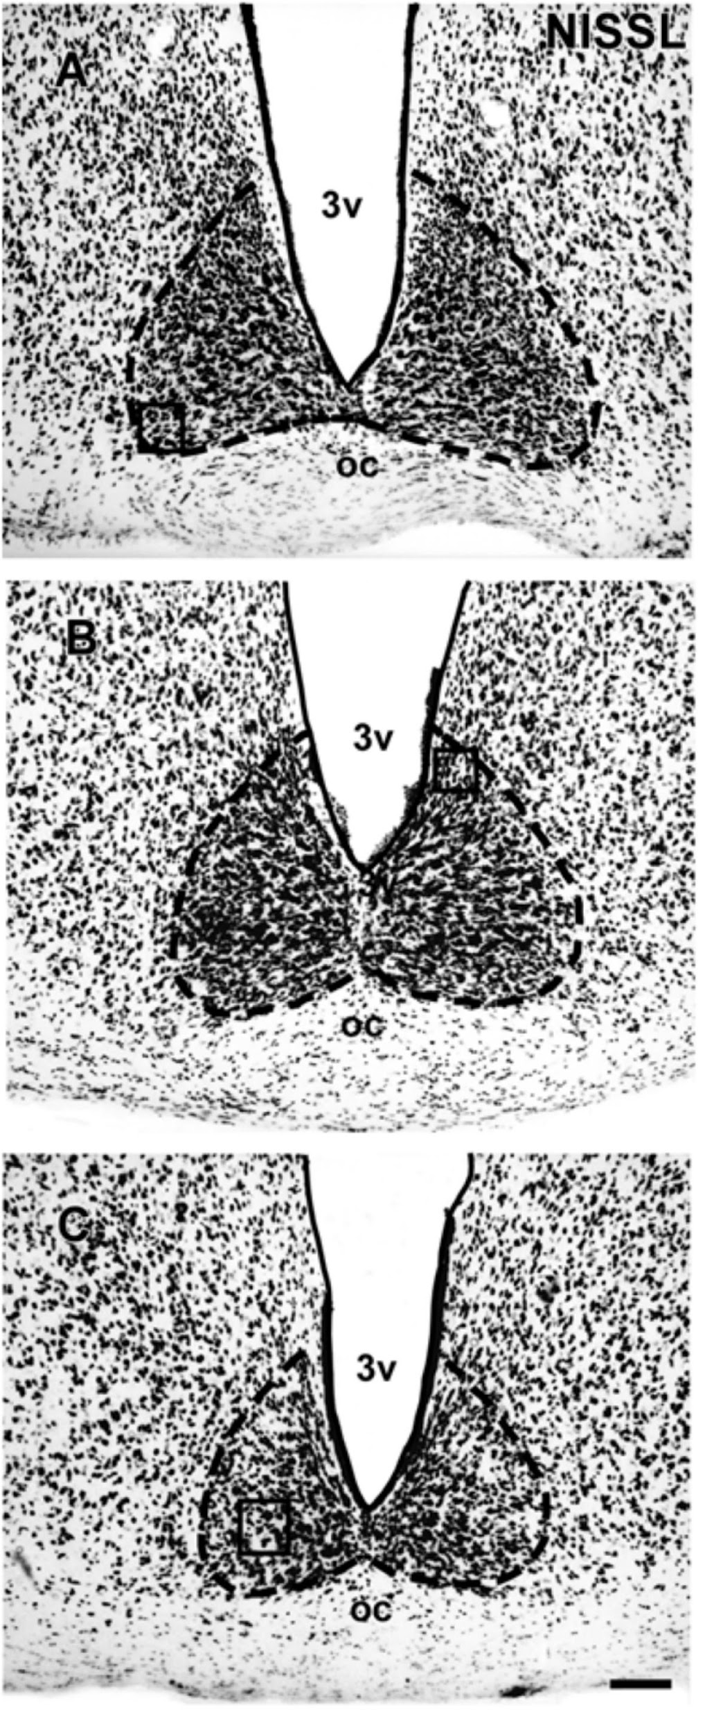
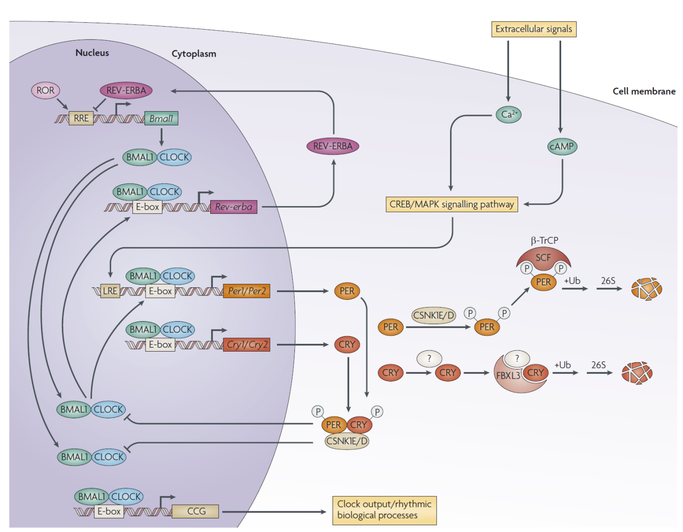
Every cell has a circadian clock
“Clock genes” regulate their own activity on a 24-hour cycle…
…and are present in every cell and tissue in the body.
The suprachiasmatic nuclei (SCN) serve as the “master pacemaker”
Third Ventricle
Suprachiasmatic Nuclei
Optic Chiasm
Takahashi, Nat Rev Genetics, 9(10): 764-75, 2008.
Logan & McClung, Nat Rev Neurosci, 2019
Nelyane, 2018; Frontiers in Neuroanatomy

Slide 16
Human circadian rhythms
Physiology
Neurobehavioral Performance
CBT_{min} = Core Body Temperature minimum
PVT = Psychomotor Vigilance Task
RT = Reaction Time
KSS = Karolinska Sleepiness Scale
Downloaded from: Principles and Practice of Sleep Medicine 5th Ed. (on 12 Jan 2012 )

Slide 17
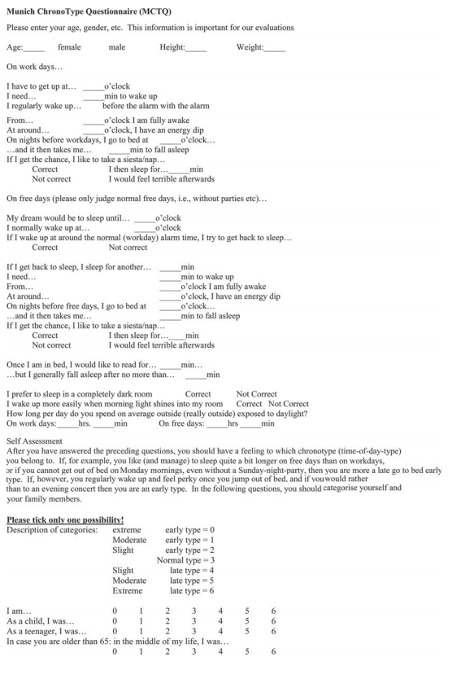
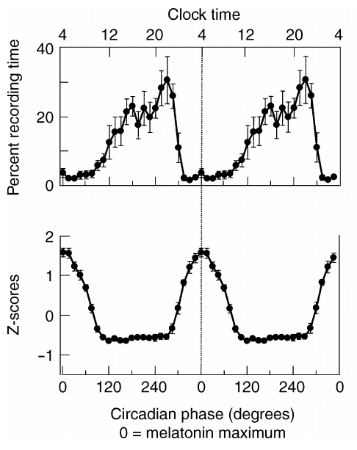
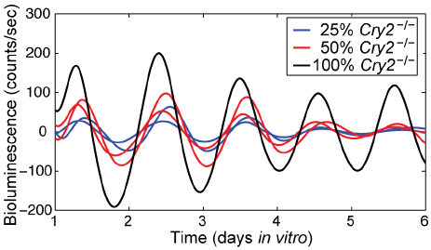
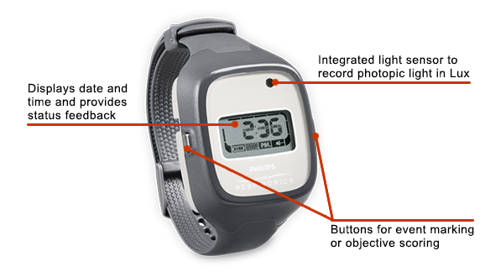
Measuring circadian rhythms
Self-Report
(Experiential)
Actigraphy
(Behavioral)
Physiology
Cellular and Molecular Activity
24 hours
Wakefulness in sleep episode
Plasma melatonin
Cajochen, J Neuroendocrinol 2003; 15, 432–437
Guenthner, 2014. PloS one. 9. e87573. 10.1371/journal.pone.0087573.

Slide 18
What are circadian rhythms good for? Drug targets
Example
Ptgs1 (Cox-1) a target of aspirin, shows circadian variation
Aspirin has a half-life of 6 hours
Mir22hg targets PTGS1, also shows circadian variation
Overlap between genes that show circadian variation, genes associated with disease, and genes that are drug targets
Zhang, Hogenesch 2014; PNAS 111 (45): 16219–16224

Slide 19
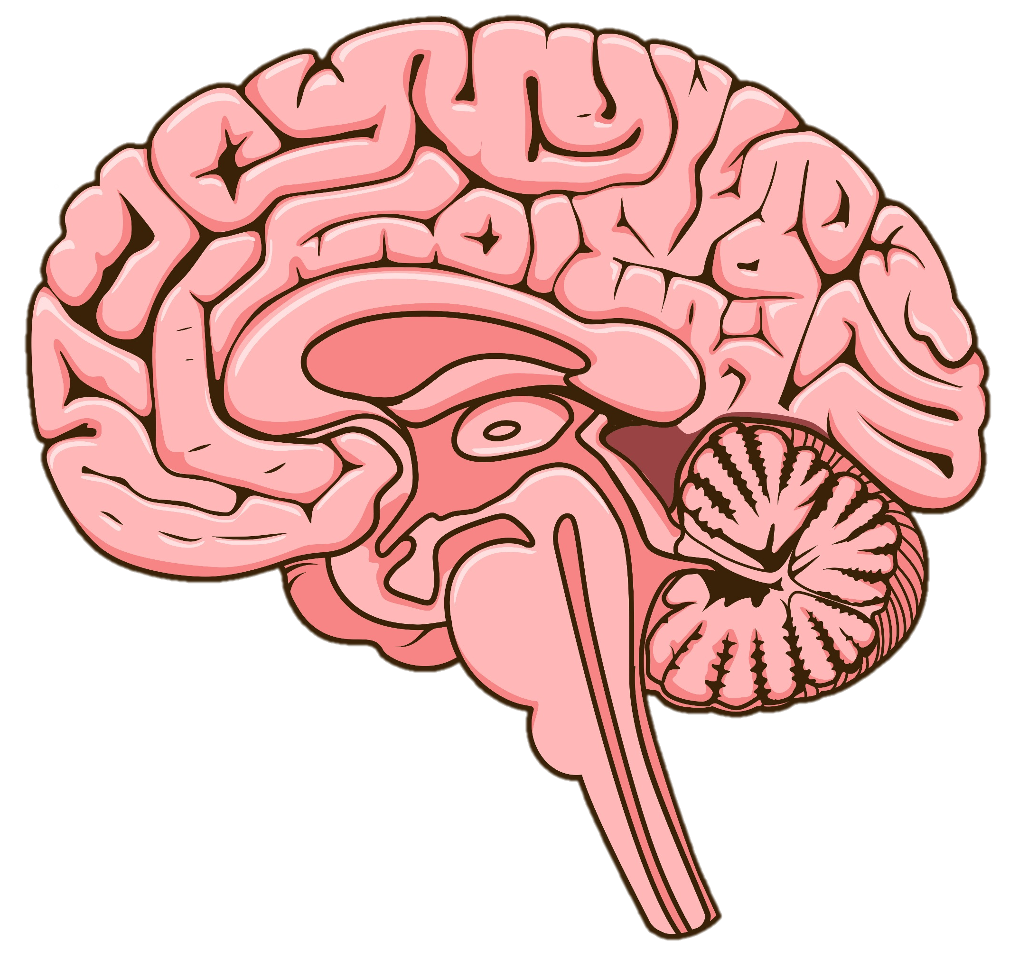
Feedback regulation of the circadian timing system by health behaviors
Health Behaviors
Physical Activity
Eating Schedule
Body Function
Metabolism
Immunity
Inflammation
Brain Function
Vigilance
Cognition
Emotion
Sleep
Light/Dark Exposure
Adapted from Videnovic, Nat Rev Neurol, 2014. 10:683–693
Physiology, Behavior, Performance

Slide 20
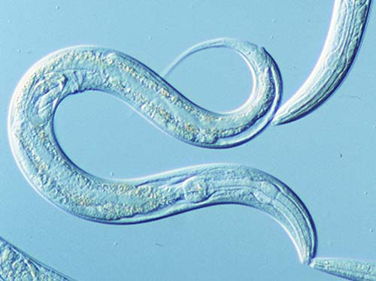
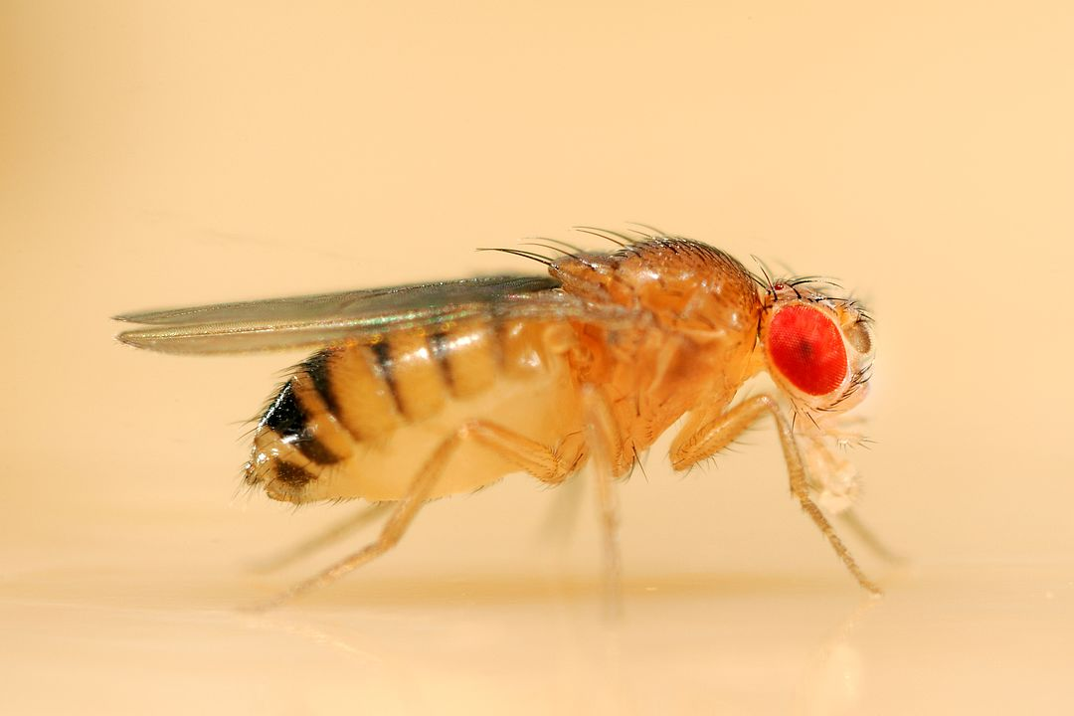
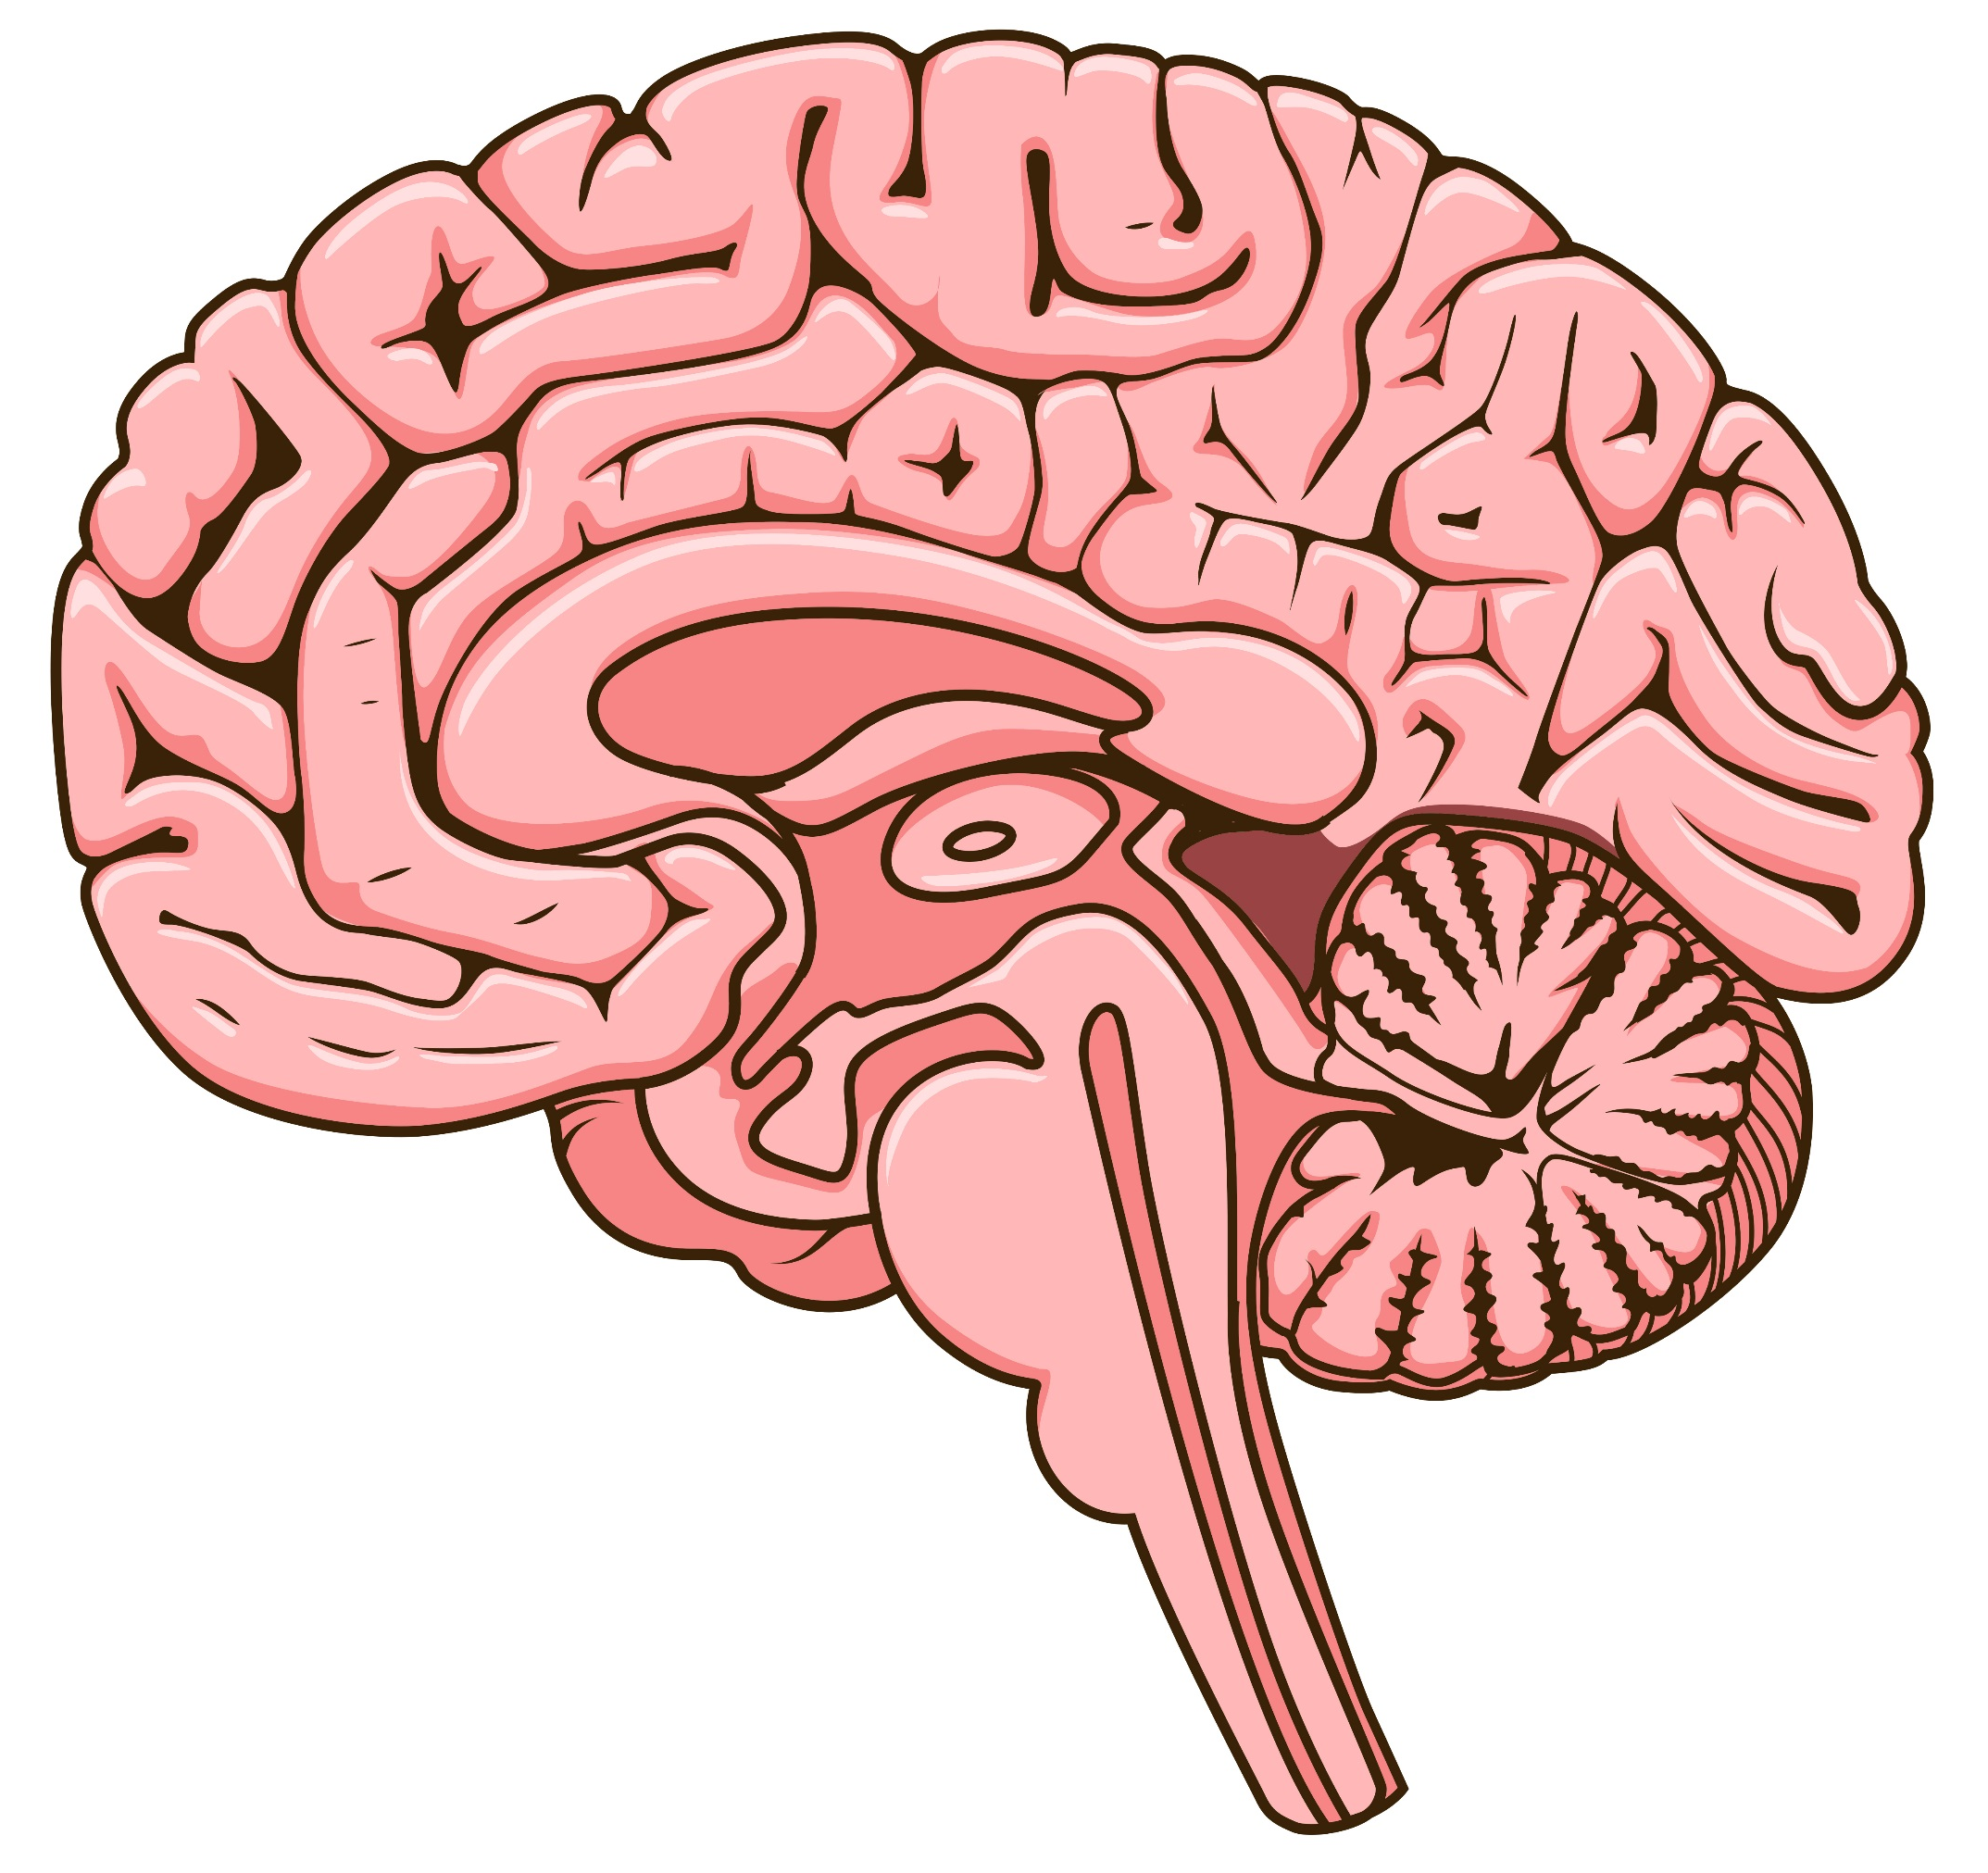
The sleep/wake cycle is the most enduring and obvious manifestation of the circadian timing system
What is sleep?
“A recurring, reversible neuro-behavioral state of relative perceptual disengagement from and unresponsiveness to the environment.”
What is the function of sleep?
To optimize adaptation and function at every level of biological organization:
Molecular energy function
Cellular
Tissue, circuit
Organ, organ system
Systemic physiology
Cognition, affect
Behavior
Carskadon and Dement, Principles and Practice of Sleep Medicine, 2005

Slide 21
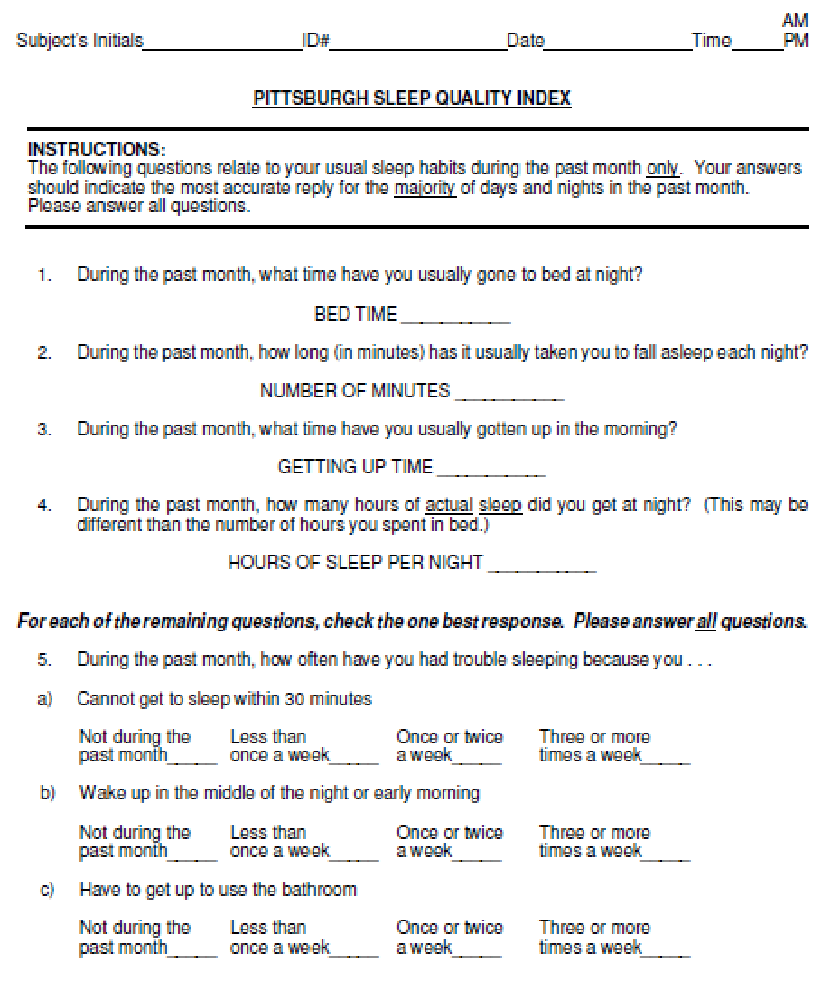
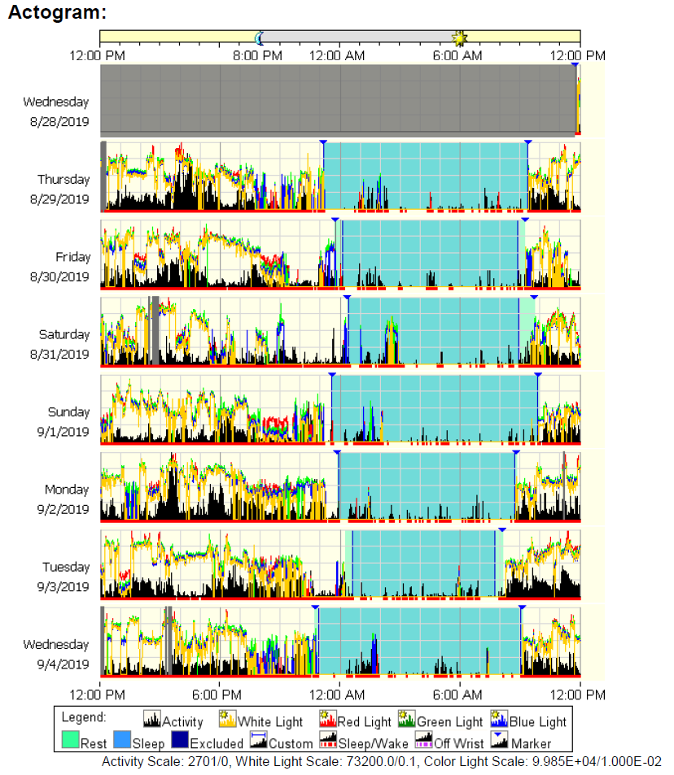
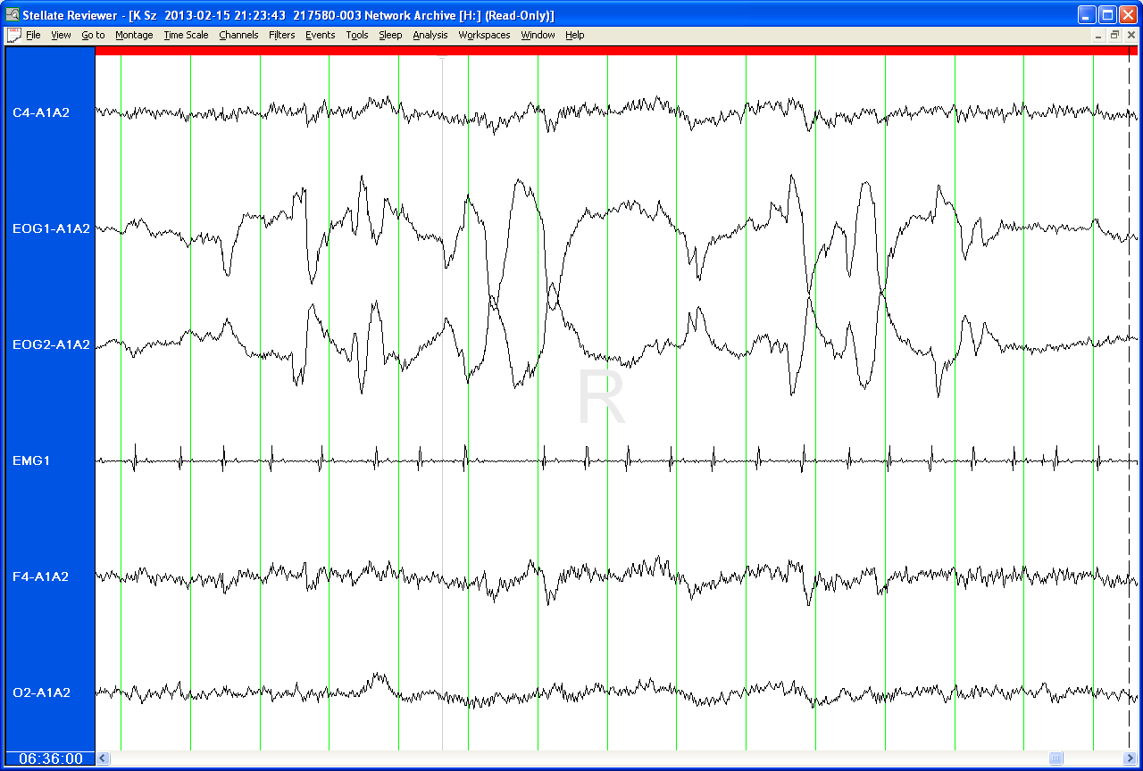
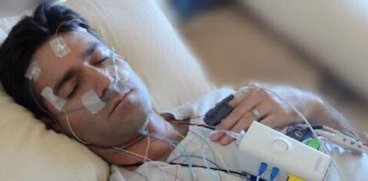
Measuring sleep
Self-Report
(Experiential)
Actigraphy
(Behavioral)
PSG
(Physiological)
Imaging
(Circuits)

Slide 22
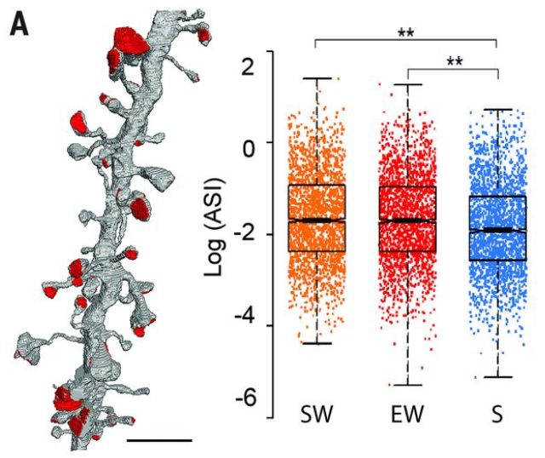
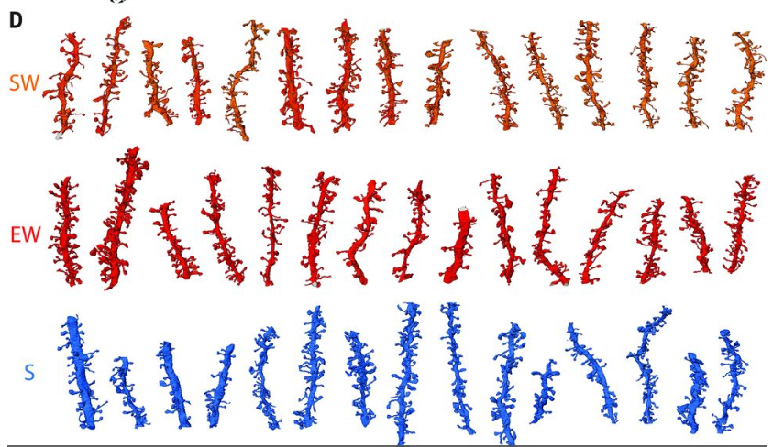
What is sleep good for? Synaptic scaling at axon-spine interface (ASI)
Dendritic segments with spines
18% Reduced ASI density after sleep
SW = Spontaneous Wake; EW = Extended Wake; S = Sleep
De Vivo, Tononi, Cirelli 2017; Science 355 (6324): 507-510 DOI: 10.1126/science.aah5982

Slide 23
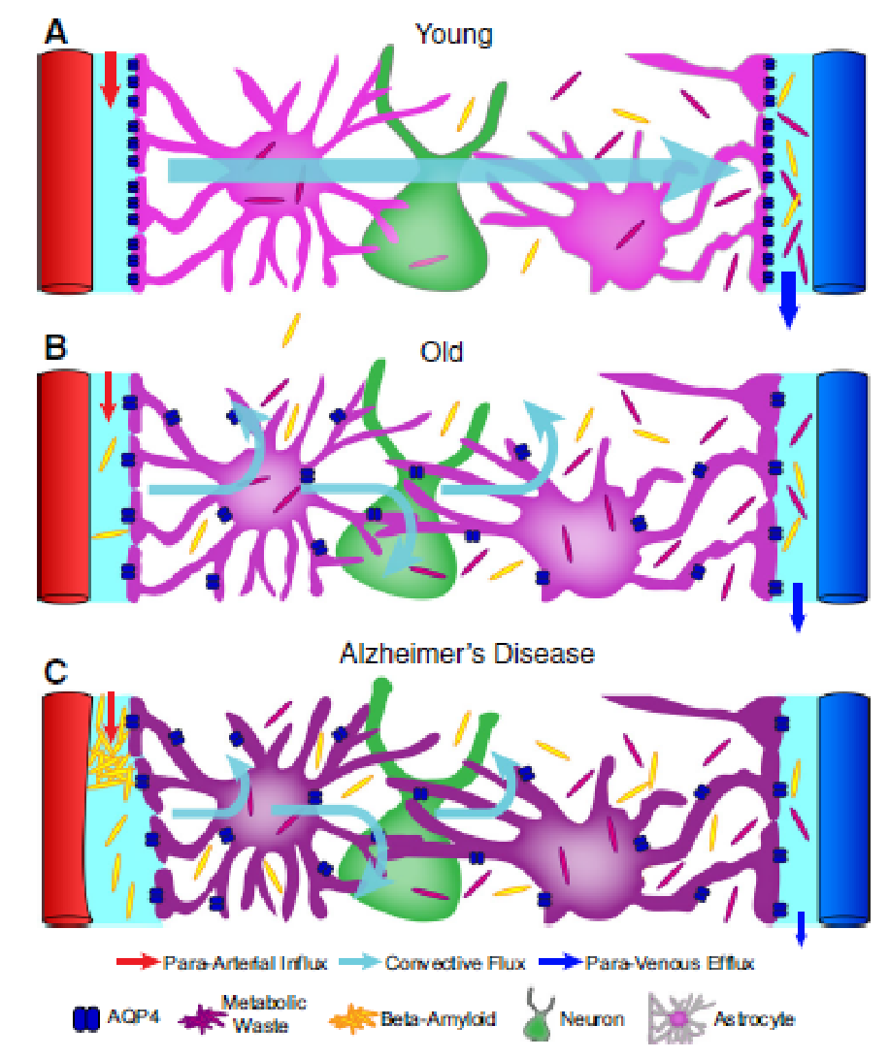
What is sleep good for? Clearance of β-amyloid
Reduced glymphatic function in aging, Alzheimer’s disease
Increased distribution of CSF tracers during sleep
Natural sleep and anesthesia result in increased exchange of CSF with interstitial fluid
Result: Increased β–amyloid clearance during sleep
Glymphatic system (CSF, interstitial fluid) functions mainly during sleep, and is disengaged during wakefulness
Xie, Science 2013; 342: 373-377. Jessen, Neurochem Res 2015; DOI 10.1007/s11064-015-1581-6

Slide 24
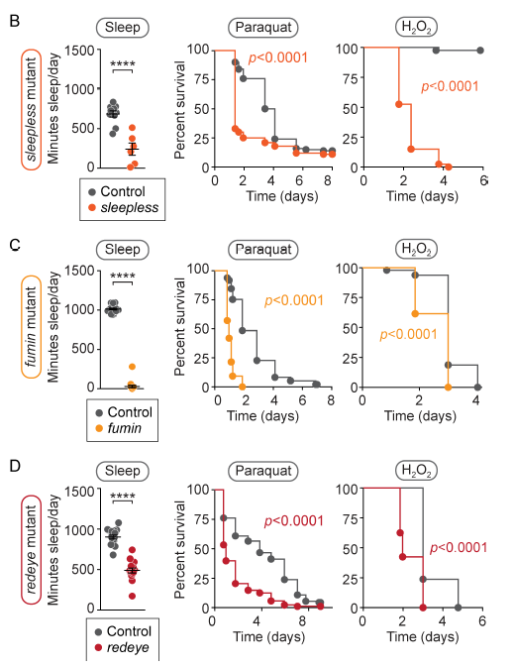
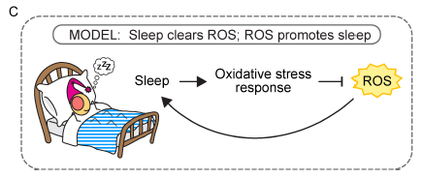
What is sleep good for? Protection from oxidative stress
Hill, 2018. PLoS Biol 16(7): e2005206. https://doi.org/10.1371/journal. pbio.2005206

Slide 25
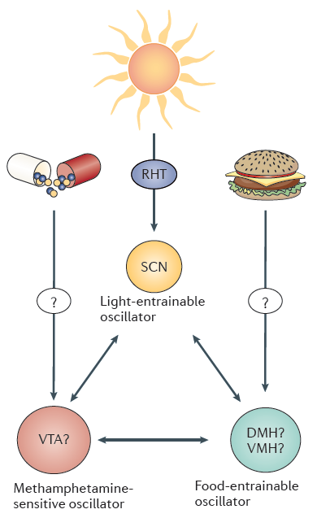
What are sleep and circadian rhythms good for? Metabolism
Food entrains circadian rhythms²
Clock gene mutations lead to obesity¹
Molecular circadian clock is tied to molecular metabolic clock^{2,7}
Eating at inappropriate time associated with food intake and weight
Animals³
Humans⁴
Sleep restriction increases appetite, reduces insulin sensitivity⁸
Time-restricted feeding prevents obesity, leads to weight loss⁵⁻⁷
Nampt
Light
Sleep
Circadian
Cellular
Molecular Clock
Metabolism
AMPK
Masri and Sassone-Corsi, 2013
Clock
Bmal
ATP
NADH
ADP
NAD+
PER
CRY
+
Physical
Wakefulness,
Activity
1
Sleep Deprivation
SIRT
¹Turek, 2005; Science 308: 1043-5, 2005. ²Masri & Sassone-Corsi, 2013; Nat Rev Neurosci 14:69-75. ³Arble, 2009; Obesity 17: 2100-2102. ⁴Baron, 2011; Obesity 19: 1374-1381. ⁵Chaix, 2014; Cell Metab 20: 991-1005. ⁶Hatori, 2012; Cell Metab 15: 848-860. ⁶Gill, Panda, 2015; Cell Metab 22: 789-798. ⁷McClung J Clin Invest 2013;
123:4994–4996. ⁸Van Cauter, 2008; Sleep Med, 9 Suppl 1, S23-28. doi:10.1016/S1389-9457(08)70013-3

Slide 26
Two perspectives on sleep-health relationships: Sleep disorders and multidimensional sleep health
Regularity
Insomnia
Sleep-Related Movement Disorders
Duration
Sleep-Related Breathing Disorders
Satisfaction
Sleep Health
Sleep Disorders
Efficiency
Alertness
Central
Disorders of Hyper-somnolence
Parasomnias
Timing
Circadian Rhythm Sleep Wake Disorders

Slide 27
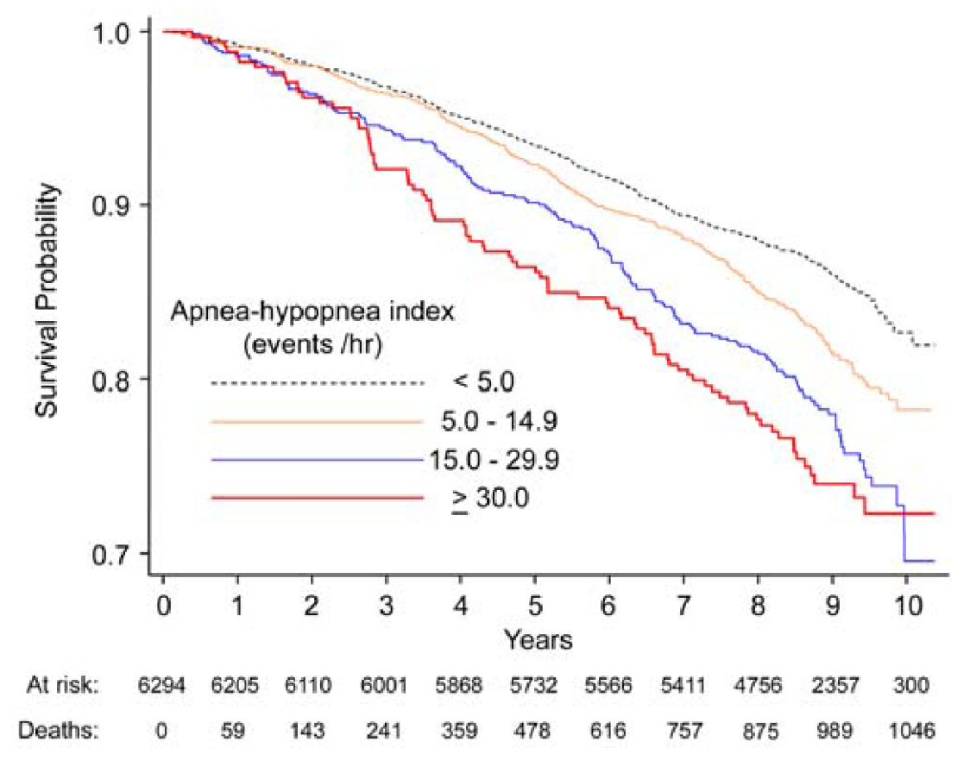
Obstructive Sleep Apnea Syndrome: Health risks¹⁻⁴
Sleep-Disordered Breathing and Mortality: Sleep Heart Health Study⁵
Cardiovascular risk
Hypertension
Coronary artery disease, stroke
Atrial fibrillation
Cardiometabolic risk
Obesity
Diabetes
Neuropsychiatric risk
Sleepiness, Inattention
Impaired cognition
Depression
¹Circulation 2012; 126: 1495-1510; ²Eur Respir J 2003; 22: 156-160; ³Thorax, 2006; 61: 945-950; ⁴Diabetes Care 2003; 26: 702-709. ⁵Punjabi, PLoS Med 2009; 6(8): e1000132. doi:10.1371/journal.pmed.1000132

Slide 28
What is sleep good for? Mental health
Meta-analysis of insomnia and future depression
Sleep duration and suicidal behavior in adolescents
*
*
*
*
*
Percent within each Sleep Duration reporting a suicidality measure
*
*
*
*
*
*
Fixed effects model OR = 2.10
Baglioni, 2011; J Affective Disord 135: 10–19
Fitzgerald, J Clin Sleep Med 2011; 7:351-356

Slide 29
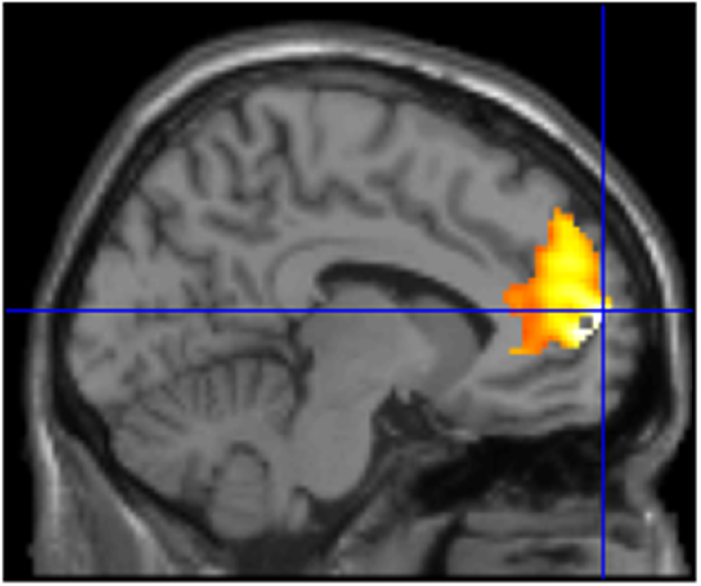
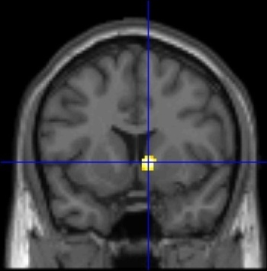
Individual sleep health dimensions are related to health outcomes: Pittsburgh studies
Shifts in Sleep Timing¹
Dimension | Outcome
Regularity | Reward function (fMRI)¹ Insulin resistance²
Satisfaction | Insulin resistance³
Alertness | BMI, waist circumference⁴
Timing | Sleep duration⁵
Efficiency | Cognitive performance⁶
Duration | Suicidality⁷ Metabolic syndrome⁸ Positive/negative affect⁹ Carotid plaque¹⁰ Mortality¹¹
Sleep Restriction⁹
Medial
PFC
Reward task
Ventral striatum
↓ during voluntary emotion regulation
High wake after sleep onset
↓to large reward
Low wake after sleep onset
¹Hasler, Biol Psychol 2012; 91:334-341. ² Taylor, Hall, SLEEP 2016; 39:457–465. ³Kline, Met Syndr Rel Disord, in press. ⁴Owens, JCSM 2010; 6:330-335. ⁵ Monk, Chronobiol Int, 2014; 31: 655-659. ⁶Wilckens, submitted. ⁷Fitzgerald, Buysse, J Clin Sleep Med 2011; 7:351-356. ⁸Hall, SLEEP 2008; 31:635–643. ⁹McMakin, Franzen, J Child Psychol Psychiatry 2016; ¹⁰Thurston, SLEEP 2017;40: zsw052, ¹¹Hall, SLEEP 2015; 38:189-195.

Slide 30
Multidimensional sleep health is related to other health outcomes
Regularity
Health Outcomes
Depression
Duration
Health risk factors in adolescence
Satisfaction
Sleep Health
#chronic disorders, self-rated health
Efficiency
Alertness
Health care costs
Timing
Cardiometabolic outcomes
Cross-sectional
Longitudinal
Teens 🡪 Older adults
Mortality

Slide 31
The sleep and circadian guide to better health
Can we use this…
To change these…
Acting through these…
To optimize these?
Interventions
Circadian Timing System
Changes in Physiology
Epigenetics
Inflammation
Immunity
Hormones
Health Outcomes
Physical Health
Mental Health
Cognitive Health
Genes, Environment, Social Interactions
Adapted from Buysse, SLEEP 2014; 37(1):9-17

Slide 32
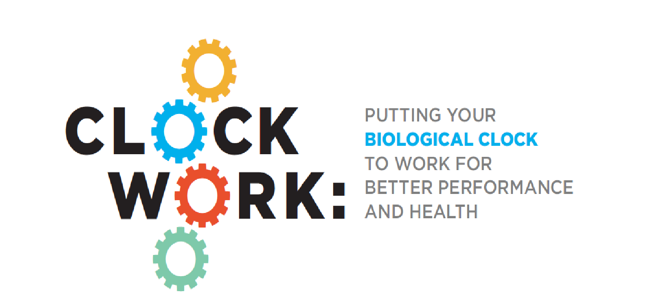
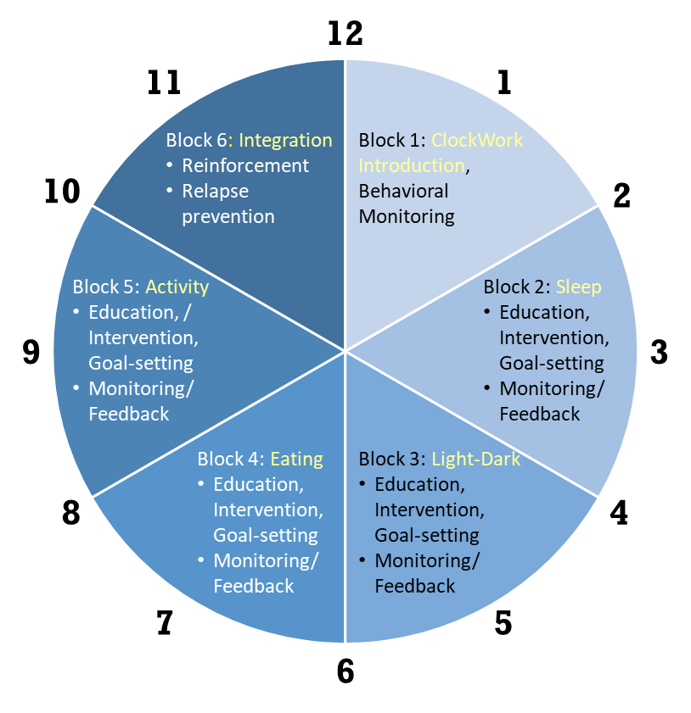
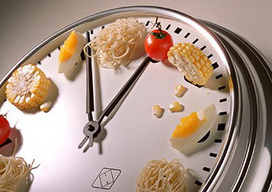
Can we use circadian rhythms and sleep to improve health? An example
The ART of ClockWork: Amount, Regularity, Timing
 | Sleep | Light/Dark | Eating | Physical Activity
Amount | 6-8 hours of sleep at >90% efficiency | 30 min bright light; 30 min darkness | 3 meals, 1-2 snacks | 30 min moderate- vigorous activity
Regularity | ± 1°, 7 days/week | ± 1°, 7 days/week | ± 1°, 7 days/week | ± 1°, 5 days/week
Timing | Mid-sleep time: 3:00-3:30am | Light: 1° after wake; Dark: 1° before bed | 12-hour eating window | Same time of day
Intervention strategies | (1) Monitoring of sleep, eating, physical activity, light/dark exposure via self-report and smart-phone/tablet apps; (2) personalized feedback; and (3) tailored health coaching
The ClockWork Program
12 sessions (6 two-week blocks)
D Buysse, M Hall, M Levine, A Saptono, P Franzen, C Kline, S Stahl, S Smagula, R Kolko, C Tighe, M Hawkins

Slide 33
The socio-ecological model and sleep and circadian health
Society: Organizations,
Policy Makers
Public policy · Cultural leadership · Regulations and incentives
Community
Community, religious, employment, and health-care systems · Social networks · Built environment
Interpersonal, small group
Family and group-based interventions · In-person, web-based social support
Individual
Sleep and circadian health interventions:
In-person · Web-based · Mobile technology
Jackson, Ann Rev Public Health 2015; 36:417-440. Stokols, Am J Health Promot 1996; 10: 282-298. McLeroy, Health Education Quarterly 1988; 15:351-377.

Slide 34
Sleep, circadian rhythms, and health: A research agenda
Basic Science
Translational Science
Clinical and Implementation Science
Circadian and sleep-related control of gene expression and regulation
Sleep-related regulation of interstitial protein clearance
Restorative function of sleep at the molecular, cellular, and physiological levels
Simple, accurate, reliable methods to identify circadian phase and amplitude in intact organisms
Effect of circadian rhythms on common therapeutics (e.g., chronopharmacology)
Intersection between sleep/ circadian physiology and metabolism at the molecular, cellular, and physiological levels
Novel measures to identify the relationship between sleep disorders (sleep apnea, insomnia, restless legs syndrome), sleep treatments, and health outcomes
Dissemination of behavioral sleep interventions
Novel sleep and circadian interventions to improve health and function at the individual, community, and societal levels

Slide 38
Sleep Overview & Prioritized Research
Panel Discussion:
Dan Buysse, Patrick Strollo, Wayne Dysinger, Abbe de Vallejo

Slide 39
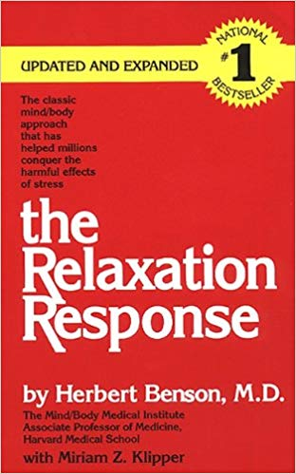
Sleep Considerations
Adopt comforting rituals before bedtime
Keep your bedroom cool, dark and quiet
Go to sleep and wake up around the same time daily
Turn off screens for 30-60 minutes before bedtime
Avoid caffeine after 2 pm, avoid alcohol within 3 hours of bedtime
Eat foods high in melatonin (tart cherries, walnuts, corn, mushrooms) and tryptophan (spirulina, chia, wheat germ, soybeans)
Exercise regularly in the morning
Be exposed to sunlight for 30 minutes every day
Institute mindfulness and meditation regimes
Black et al. Mindfulness Meditation
and Improvement In Sleep Quality.
JAMA Intern Med. 2015 Apr 1;
175(4): 494–501.
Kent L, Lifestyle Medicine strategies to enhance sleep. Avondale College Newsletter.

